Slide 1
Nuts and Bolts of Program Sustainability
Developing a Conceptual Framework to Assess the Sustainability of a Simulation Program
John Gillespie, Education Services Specialist

Slide 2
Objectives:
Identify four components that are key to a sustainable model
Identify at least three areas in each section to assist in the modeling process
Identify where you can get assistance

Slide 3
A picture is worth a thousand words…
What does your simulation path look like?

Slide 4
Are you a Champion to Simulation?

Slide 5
Or are you creating a simulation program that is organizationally driven?

Slide 6
Four areas of focus:
Organizational Buy In
Overcoming Barriers to Simulation
Faculty/Personnel Development
Curriculum Integration

Slide 7
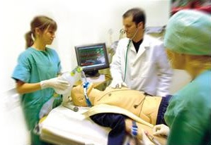
From the evidence… what is needed to incorporate simulations into a curriculum?
Administrative support
Technology support and infrastructure
Equipment resources
Curriculum plan
Faculty development
Reference: Pamela R. Jeffries PhD, RN, FAAN, ANEF- Professor of Nursing, Vice Provost for Digital Initiatives- Johns Hopkins University
Presentation: Simulation-Based Curriculum and the integration of vSims Retrieved from Laerdal American Sales Meeting 2014
Notes:
There are some important things to think about when incorporating simulations into our curriculum.
We’ll go over each one of these.

Slide 8
Organizational Buy In
ROI (Return on Investment)
ROE (Return on Expectation)
Utilization Data Collection
Evaluation Data Collection
Leading indicators are usually pretty close to accurate
Policy and Procedures that are specific to your organization
Care about what keeps your organizational leaders up at night
Create a value statement
Insure that the stakeholder gets a regularly scheduled report

Slide 9
Overcoming Barriers to Simulation
Identify your internal and external customers
What is your customer service model?
Identify your barriers to simulation from an organizational perspective through the use of a task force
One tool to help with this is a task force created survey of your organization to identify barriers to use
Partner with Risk Management/ Curriculum Committee

Slide 10
Overcoming Barriers to Simulation
Create a concept map for organization integration
-Map out how and where simulation is going to be used
Budget your simulator and or scenario purchases so that they are directly tied to your organization’s learning objectives
Monitor your action plans

Slide 11
Overcoming Barriers to Simulation
Example of a curriculum map
Course | Hours | Lecturer | Possible SIM
Semester 1 | 460
(i)The art and science of Clinical medicine | 20 | Smith
Medical Professionalism/Bioethics |  | Smithfield | X
Health and Development |  | #
Soft skills |  |  | X
Interviewing techniques |  |  | X
Writing and presenting patient interviews
(ii)Structure and Function
Anatomy 1 (Back, Upper limb, Lower limb, Abdomen & Pelvis) | 150
Physiology1 (General physiology & Systemic physiology) | 100 |  | X
Cell biology/Histology 1 | 30 |  | X
Embryology 1 | 30
(iii)Determinants of Community Health | 20 |  | X
Research Methodology |  | Johnson/ Holder
Occupational and Environmental Health
Epidemiology
(iv) Metabolism and Nutrition | 100
Biochemistry 1 |  |  | X
Molecular Biology |  | Andrews

Slide 12
Overcoming Barriers to Simulation
Are your simulations effective?
Are your simulations academically effective?
Are your simulations organizationally effective?
Are your simulations operationally effective?

Slide 13
Measuring Outcomes
The effectiveness of your program is only as relevant as the effectiveness of the tool(s) that you are using to measure it by.

Slide 14
Measuring Outcomes
The effectiveness of your program is only as relevant as the effectiveness of the tool(s) that you are using to measure it by.
Using the Kirkpatrick model, as one example, you can and should measure the effectiveness of the learning objectives met right after the simulation and then again 6 months later.

Slide 15
Measuring Outcomes
The effectiveness of your program is only as relevant as the effectiveness of the tool(s) that you are using to measure it by.
Using the Kirkpatrick model, as one example, you can and should measure the effectiveness of the learning objectives met right after the simulation and then again 6 months later.
Is the behavior reflecting what was learned during simulation (Debriefing)? Report this back to the stakeholder. Are you indicating a beneficial return on investment?

Slide 16
Faculty Development
Create a Faculty Development program through the Simulation Task Force that focuses on a needs assessment or survey results
This method gives “ownership” to the end users
Next, repeat the course on a smaller scale to develop good simulation “habits”
Reference the policy guide
Create a standardized competency check off tool that you show to the faculty. This will give them a goal.

Slide 17
Curriculum Integration
While partnering with the curriculum committee / risk management, thoughtfully integrate in small doses over a long period.
3 years for a small/medium sized organization
(Practical Health Care Simulations, Paperback – July 30, 2004)
by Gary E. Loyd MD (Author), Carol L. Lake MD MBA MPH (Author), Ruth Greenberg PhD (Author)
ISBN-13: 978-1560536253 ISBN-10: 156053625X Edition: 1st
In academia, “back into” the curriculum by starting your first simulations with the graduating student body.
Insure quality over quantity.

Slide 18
Curriculum Integration
Tie all scenarios to clinically relevant learning objectives
Tie all scenarios to clinically relevant learning objectives
Tie all scenarios to clinically relevant learning objectives
Utilize your task force as a simulation creation and peer review committee

Slide 19
How is simulation use valuable?
Value 1- Simulation is only valuable if you use it.
A simulator that is unused/under utilized has no value.
Worse, it is a cost center and a financial drain on the organization.

Slide 20
How is simulation use valuable?
Value 2.- Educationally effective simulation not only allows the learners to “connect the dots”, but it also can change behaviors in an organization.
The result can allow you to focus your training dollars to effect
Reduce your malpractice costs
Reduce time spent in training
Improve patient outcomes

Slide 21
How is simulation use valuable?
Value 3.- Use as a recruiting tool to draw in candidates that increase the overall value of your organization.

Slide 22
How is simulation use valuable?
Value 4.- Repeatability regardless of the patient census at any given moment.
Allows for a consistent product to be delivered to the learners.

Slide 23
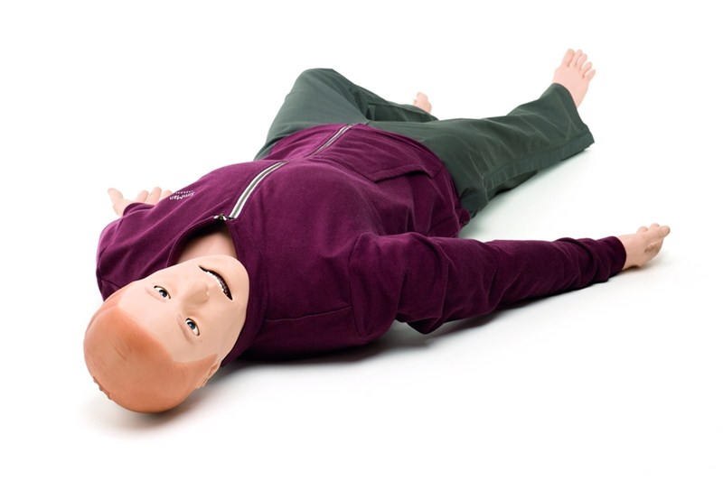
Thank you for your attendance at Laerdal’s San Diego SUN Conference
“Questions & feedback”

